Slide 1

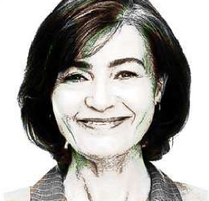


Cynthia
Type: Veteran
Service Era: Post 9/11
Technology Adoption: N/A
Patient Condition(s): Diabetes, Hypertension, and Respiratory,
Neurological, & Autoimmune Symptoms
Source: Human Factors Engineering (HFE), Office of Health
Informatics, Veterans Health Administration
Open Persona
Anna
Type: Caregiver - Family Member
Service Era: Post 9/11
Technology Adoption: Early Adopter
Patient Condition(s): Traumatic Brain Injury (TBI)
Source: Enterprise Veterans Self Service (EVSS),
US Department of Veterans Affairs
Open Persona
Debra
Type: Clinician
Occupation/Specialty: MD, FACG - Gastroenterologist
Technology Adoption: Early Adopter
Source: Human Factors Engineering (HFE), Office of Health
Informatics, Veterans Health Administration
Open Persona
Kristen
Type: VA Staff
Occupation/Specialty: Quality, Safety, Value Analyst
Technology Adoption: Mainstream Adopter
Source: Human Factors Engineering (HFE), Office of Health
Informatics, Veterans Health Administration
Open Persona

